Slide 1

Introduction to
Robotic Process Automation
GYM
MEMBERSHIP
AUTOMATION
220701092
HINDUSHA K
Mrs. J. Jinu Sophia
Assistant Professor (SG)

Slide 2

Abstract
▪ The Gym Membership Automation project aims to simplify and
streamline the process of booking sessions for gym members. The
system automates the selection and booking of available gym
sessions based on user preferences, such as session type, date,
and available slots. Using an intelligent automation framework,
the solution checks available slots, confirms bookings, and sends
automated email confirmations to the members. This project
integrates multiple functionalities, including session management,
email notifications, and real-time availability updates, ensuring
that members can easily reserve their spots without manual
intervention. The overall goal is to enhance user experience,
reduce administrative workload, and improve operational
efficiency at the gym.
Department of Computer Science and Engineering
Rajalakshmi Engineering College
2

Slide 3
Need for the Proposed System
▪ In a traditional gym membership system, members often face
challenges when booking sessions due to limited administrative
support and manual processes. These manual systems can lead to
errors in managing bookings, confusion regarding available slots,
and delays in processing membership requests. Additionally, gym
staff may spend a significant amount of time handling session
schedules and member inquiries, which reduces the overall
efficiency of operations. The proposed system addresses these
issues by automating the process of session booking, ensuring real
-time availability updates, and sending instant email confirmations
to members.
Department of Computer Science and Engineering
Rajalakshmi Engineering College
3

Slide 4
Advantages of the Proposed System
▪ Increased Efficiency: Automates membership and booking
processes, reducing manual effort.
▪ Real-Time Updates: Provides accurate availability,
minimizing booking conflicts.
▪ Instant Confirmation: Sends automatic booking
confirmations to members.
▪ Reduced Errors: Minimizes human errors in scheduling and
data entry.
▪ Better Member Experience: Easy-to-use interface for quick
booking and session management.
▪ Cost and Time Savings: Lowers administrative costs and
time spent on manual tasks.
Department of Computer Science and Engineering
Rajalakshmi Engineering College
4

Slide 5
Literature Survey
Paper 1: "Smart Fitness System Using Cloud Computing and IoT"
Advantage:
● Real-Time Access: Integrating IoT with cloud computing allows gym members and staff to access
up-to-date information on available slots and bookings instantly, improving convenience.
Disadvantage:
● Security Risks: Storing sensitive user data on the cloud raises potential security and privacy
concerns, requiring robust safeguards to prevent data breaches.
Paper 2: "Automating Gym Management Systems Using IoT and Cloud Technologies"
Advantage:
● Enhanced Member Experience: The integration of IoT devices with automation provides real-time
data on gym equipment and space availability, enabling members to make quick bookings and
adjustments to their schedules.
Disadvantage:
● Dependence on Technology:Heavy reliance on cloud and IoT technology for gym operations may
cause disruptions in case of system failures or connectivity issues, affecting both bookings and
member experience.
Department of Computer Science and Engineering
Rajalakshmi Engineering College
5

Slide 6
Main Objective
▪ The primary objective of gym membership booking automation is
to simplify the booking process using technology like Robotic
Process Automation (RPA). This reduces manual effort, minimizes
errors, and enhances the user experience. By automating tasks
such as checking slot availability, confirming bookings, and
managing records, the system saves time for both staff and
members. It ensures accuracy by preventing booking errors and
maintaining up-to-date member records. With an easy-to-use
interface, users can book sessions seamlessly and receive instant
email confirmations. The system is scalable, handling increased
demand without adding staff and efficiently managing records for
reference. Ultimately, it aims to provide a fast, reliable, and
transparent booking system that enhances user satisfaction.
Department of Computer Science and Engineering
Rajalakshmi Engineering College
6

Slide 7
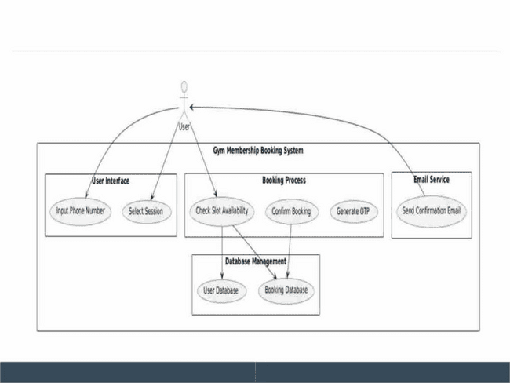
Architecture
Department of Computer Science and Engineering
Rajalakshmi Engineering College
7

Slide 8
System Requirements
§Hardware Requirements
1.Processor: Dual-core processor (Intel i3 or equivalent) or higher.
2.RAM: Minimum 8 GB for smooth operation.
3.Storage: At least 50 GB free space for software, logs, and data storage.
4.Display: Standard monitor with 1080p resolution.
5.Internet Connection: Stable broadband connection for email access.
6.Peripheral Devices: Keyboard, mouse, and optionally a printer for report generation.
§Software Requirements
1.Operating System: Windows 10 or higher, or macOS 10.13+.
2.UiPath Studio: Installed and configured (preferably UiPath Cloud Studio).
3.Email Client: Access to a configured IMAP/SMTP server (e.g., Gmail or any business email).
4.Activity Packages:
1.UiPath.Mail.Activities (for IMAP/SMTP functionality).
2.UiPath.Excel.Activities (for logging emails to Excel).
5.Microsoft Excel/LibreOffice: For managing email logs and reports.
6.Programming Frameworks: .NET Framework 4.7.2 or higher for UiPath operations.
Department of Computer Science and Engineering
Rajalakshmi Engineering College
8

Slide 9
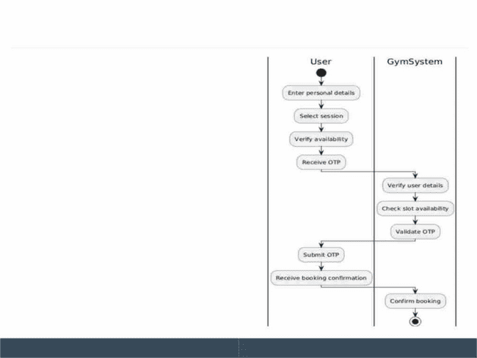
Functional Description
Module 1: Membership Registration
& Slot Booking
Short Description:
This module allows users to register
for gym membership by entering
personal details. After registration,
users can select and book available
gym sessions based on real-time
availability.
Department of Computer Science and Engineering
Rajalakshmi Engineering College
9

Slide 10
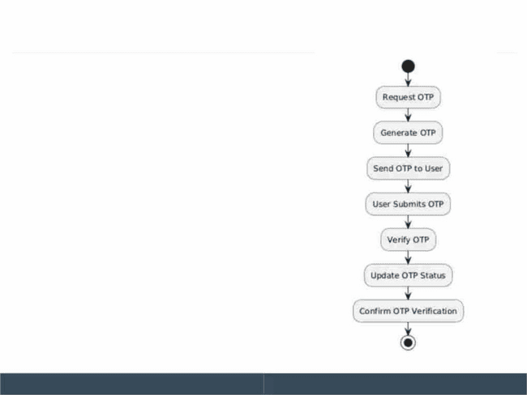
Functional Description
Module 2: Booking Management &
Email Notification
Short Description:
This module manages the booking
process, ensures proper tracking of
available slots, and sends
confirmation emails to users.
Department of Computer Science and Engineering
Rajalakshmi Engineering College
10

Slide 11
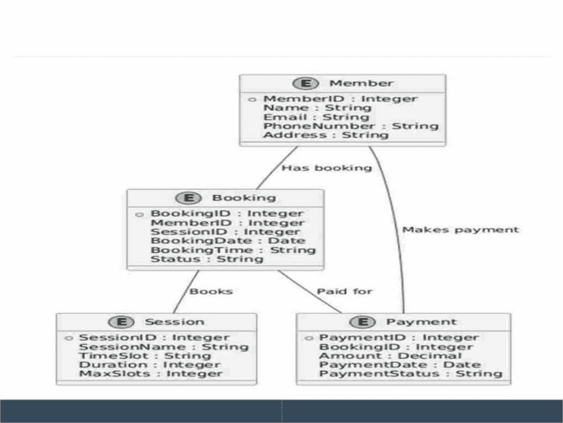
Table Design
Department of Computer Science and Engineering
Rajalakshmi Engineering College
11

Slide 12
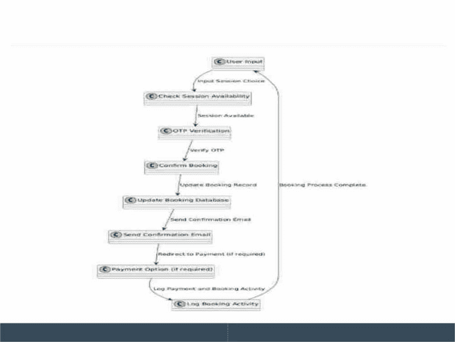
Process Design
Department of Computer Science and Engineering
Rajalakshmi Engineering College
12

Slide 13
Implementation
Implementation of Module 1: User Input and Session Selection
Description:
Module 1 involves collecting user details (name, email, phone number) and
selecting a session for booking. The system checks session availability,
confirms the selection, and sends an OTP for verification.
Steps:
1. Collect User Info: User enters name, email, and phone number.
2. Select Session: User chooses a session and its timing.
3. Check Availability: System verifies if slots are available.
4. Confirm Details: User confirms the entered information and session.
5. OTP Verification: System sends OTP for final verification.
Department of Computer Science and Engineering
Rajalakshmi Engineering College
13

Slide 14
Implementation
Implementation of Module 2: Booking Confirmation and Record
Maintenance
Description:
Module 2 handles the final confirmation of the booking, updates records,
and sends a confirmation email to the user.
Steps:
1. OTP Verification: User enters the OTP received on their phone/email.
2. Booking Confirmation: System confirms the session booking.
3. Update Records: The booking details are stored in the system’s
database (Excel file).
4. Send Confirmation Email: A confirmation email with session details is
sent to the user.
Department of Computer Science and Engineering
Rajalakshmi Engineering College
14

Slide 15
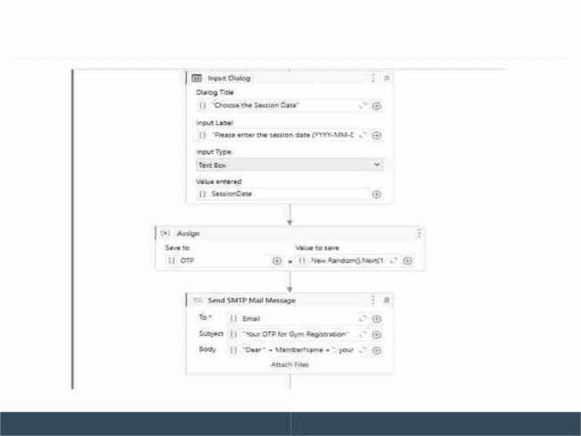
Implementation
Department of Computer Science and Engineering
Rajalakshmi Engineering College
15

Slide 16
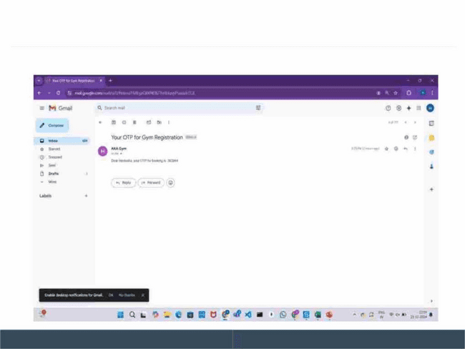
Testing
OTP FOR VERIFICATION
Department of Computer Science and Engineering
Rajalakshmi Engineering College
16

Slide 17
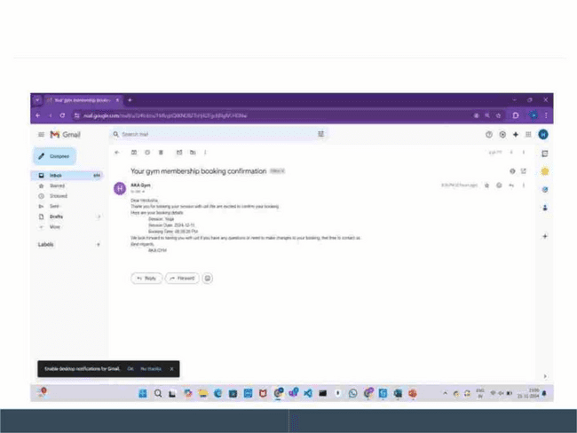
Testing
BOOKING CONFIRMATION EMAIL
Department of Computer Science and Engineering
Rajalakshmi Engineering College
17

Slide 18
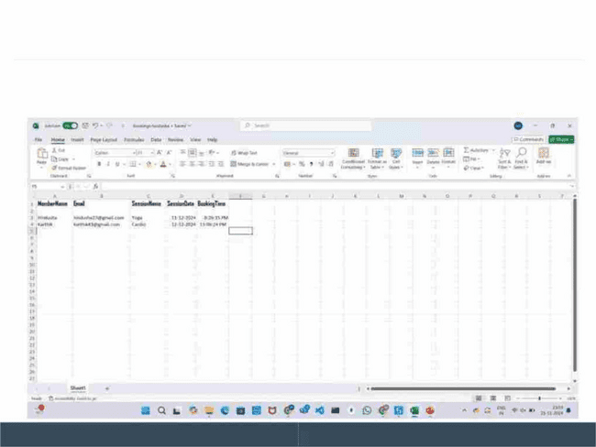
Testing
BOOKING DETAILS LOG
Department of Computer Science and Engineering
Rajalakshmi Engineering College
18

Slide 19
Conclusions
The Gym Membership Booking Automation system enhances the
traditional manual booking process by reducing human errors,
saving time, and improving user experience. It offers a seamless
and secure environment where members can easily book sessions,
receive instant confirmations, and track membership details. The
system optimizes booking and improves gym resource
management. Overall, it boosts efficiency, scalability, and
convenience for both staff and members, making it a valuable tool
for modern gym management.
Department of Computer Science and Engineering
Rajalakshmi Engineering College
19

Slide 20
Future Enhancement
Full Automation of Payment and Membership Renewal: Future
improvements can involve the complete automation of payment
processing and membership renewal. This would eliminate the need for
manual intervention, ensuring that members are automatically billed
based on their membership plan and renewing their memberships
without any reminders, offering a seamless experience for the gym and
its members.
Real-time Slot Availability and Waiting List Automation: The system can
be further enhanced to include real-time tracking of available slots and a
fully automated waiting list. If a session is fully booked, members can
automatically be added to a waiting list, and once a slot becomes
available, they will receive an immediate notification to confirm their
booking.
Department of Computer Science and Engineering
Rajalakshmi Engineering College
20

Slide 21
IEEE Paper
"Fully Automatic Gym Exercises Recording: An IoT Solution":
This paper discusses the integration of Internet of Things (IoT) devices in gym
equipment to automate exercise tracking. It includes a beacon embedded on
the gym equipment, a smartwatch for user tracking, and a cloud-based
dashboard for gym managers to monitor usage in real time. The system
provides a low-cost solution for automating gym session recording, enhancing
both user experience and gym management
"Virtual Gym Tracker: AI Pose Estimation":
This paper introduces a virtual gym tracker using artificial intelligence for pose
estimation. The system utilizes computer vision techniques to track users'
exercises based on their poses, which is useful for providing real-time
feedback on exercise performance. The approach enhances gym automation
by offering automated tracking without requiring manual input IEEE Xplore
.
Department of Computer Science and Engineering
Rajalakshmi Engineering College
21

Slide 22

References
"Robotic Process Automation: A Survey and Future Directions"
● Journal: International Journal of Advanced Computer Science and
Applications (IJACSA)
● Link: IJACSA Paper on RPA
"Internet of Things for Smart Healthcare"
● Journal: IEEE Access
● Link: IEEE Access - IoT Smart Healthcare
"A Survey of Cloud Computing Technologies in the Fitness Industry"
● Journal: Future Generation Computer Systems
● Link: Future Generation Computer Systems - Cloud Fitness
"Smart Fitness System Using Cloud Computing and IoT"
● Journal: Journal of Network and Computer Applications
● Link: Journal of Network and Computer Applications
Department of Computer Science and Engineering
Rajalakshmi Engineering College
22

Slide 23

Queries
The gym membership booking automation project
simplifies the booking process using Robotic Process
Automation (RPA). It reduces manual effort, minimizes
errors, and improves user experience. Automation
includes checking slot availability, confirming bookings,
and managing records, saving time for both staff and
members. The system ensures accuracy, allowing users
to seamlessly book sessions and receive instant
confirmations. It also handles increased demand without
additional staff, ensuring scalability and efficient record
management. Challenges such as system integration,
user resistance, and maintenance need addressing.
Understanding their impact on customer retention, staff
workload, and system performance is key to optimizing
the user experience.

Slide 24

Demonstration

Slide 25
Thank You

